Slide 1
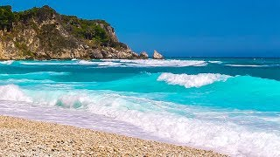
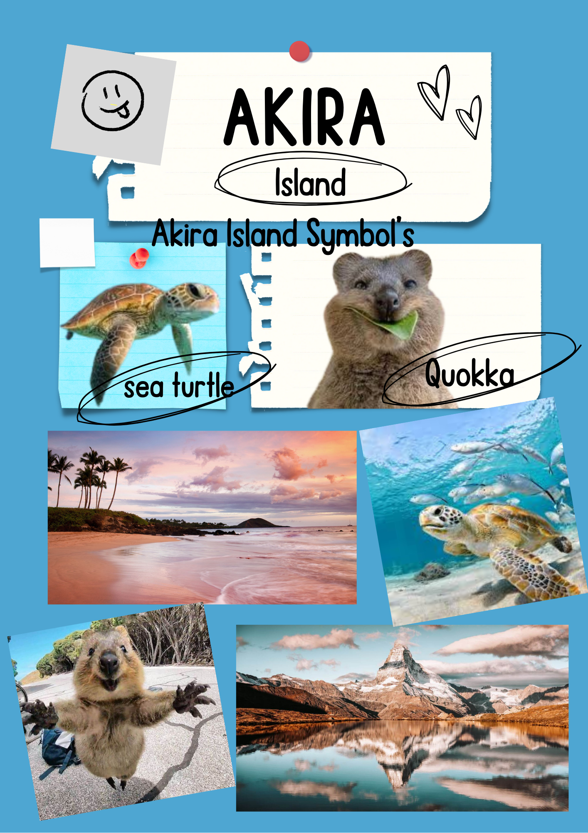
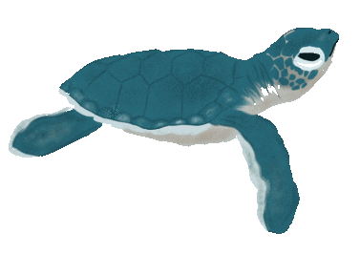
Akira Island
Group 1
. Mereana
. Anahera
. Waimarie
Sea turtles represent our marine ecosystem their presence and wellbeing are indicators of a healthy marine ecosystem.
Quokkas represent happiness and positivity due to there friendly appearance and smiling expression.
Notes:
Good introduction a little short

Slide 2


THIS IS AKIRA ISLANDS FLAG
The inspiration for this flag was islands and also inspirations from other flags And we did blue to represent water around Akira Island. The flower in the middle of the flag represents joy , pleasure , friendship and forgiveness.
Notes:
Anahera:

Slide 3

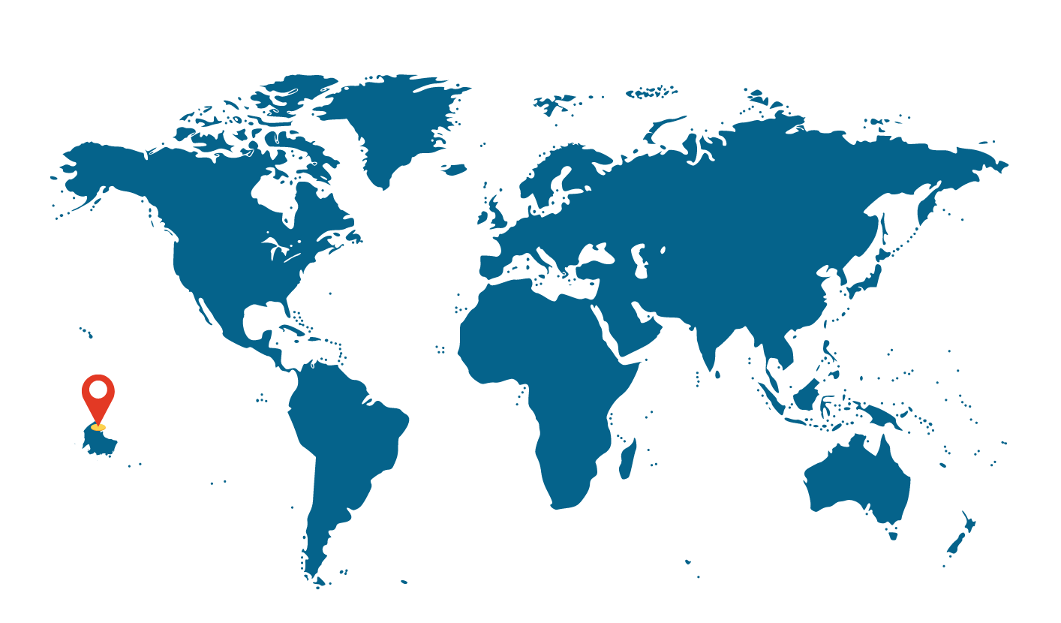
MAP
Akira island is located in the pacific ocean

Slide 4
Akira Island’s government system is Democracy
Everyone gets two votes one for a local candidate one for a political party. The candidate that gets the most votes in each local area wins.
The second vote (for the party) decides how many seats each party gets the more votes the more seats they take up.
Democracy is a system of government in which people hold the power to elect their representatives and determine the laws that govern them.
Akira’s voting system is MMP
(mixed member proportional)
Notes:
Very good!

Slide 5
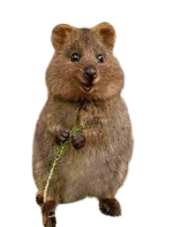
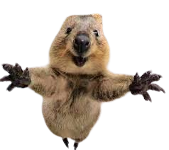
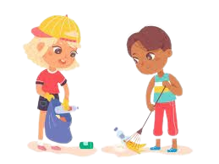
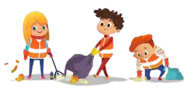
Traditions and Festivals
Quokka day
Quokka day is held on 20th june every year.This is one of everybody's favourite day of the year! Because they spend the entire day hanging with the local Quokkas.
National beach clean up day
This is held on the 7th of May & 21st of November every year
The government of Akira Island made this day up to keep our island and beaches clean.
Notes:
Really good to have the traditions and public holidays. Good conceptual connection between forming a society and speciifics with your traditions.

Slide 6
Traditions and Festivals
National sea turtle day
Sea turtle day is held on 21st of june it's where we help the baby sea turtles go into the water and go diving and explore the coral reef.
Akira island day
Is held on 21st of December celebrating Akira islands history.

Slide 7
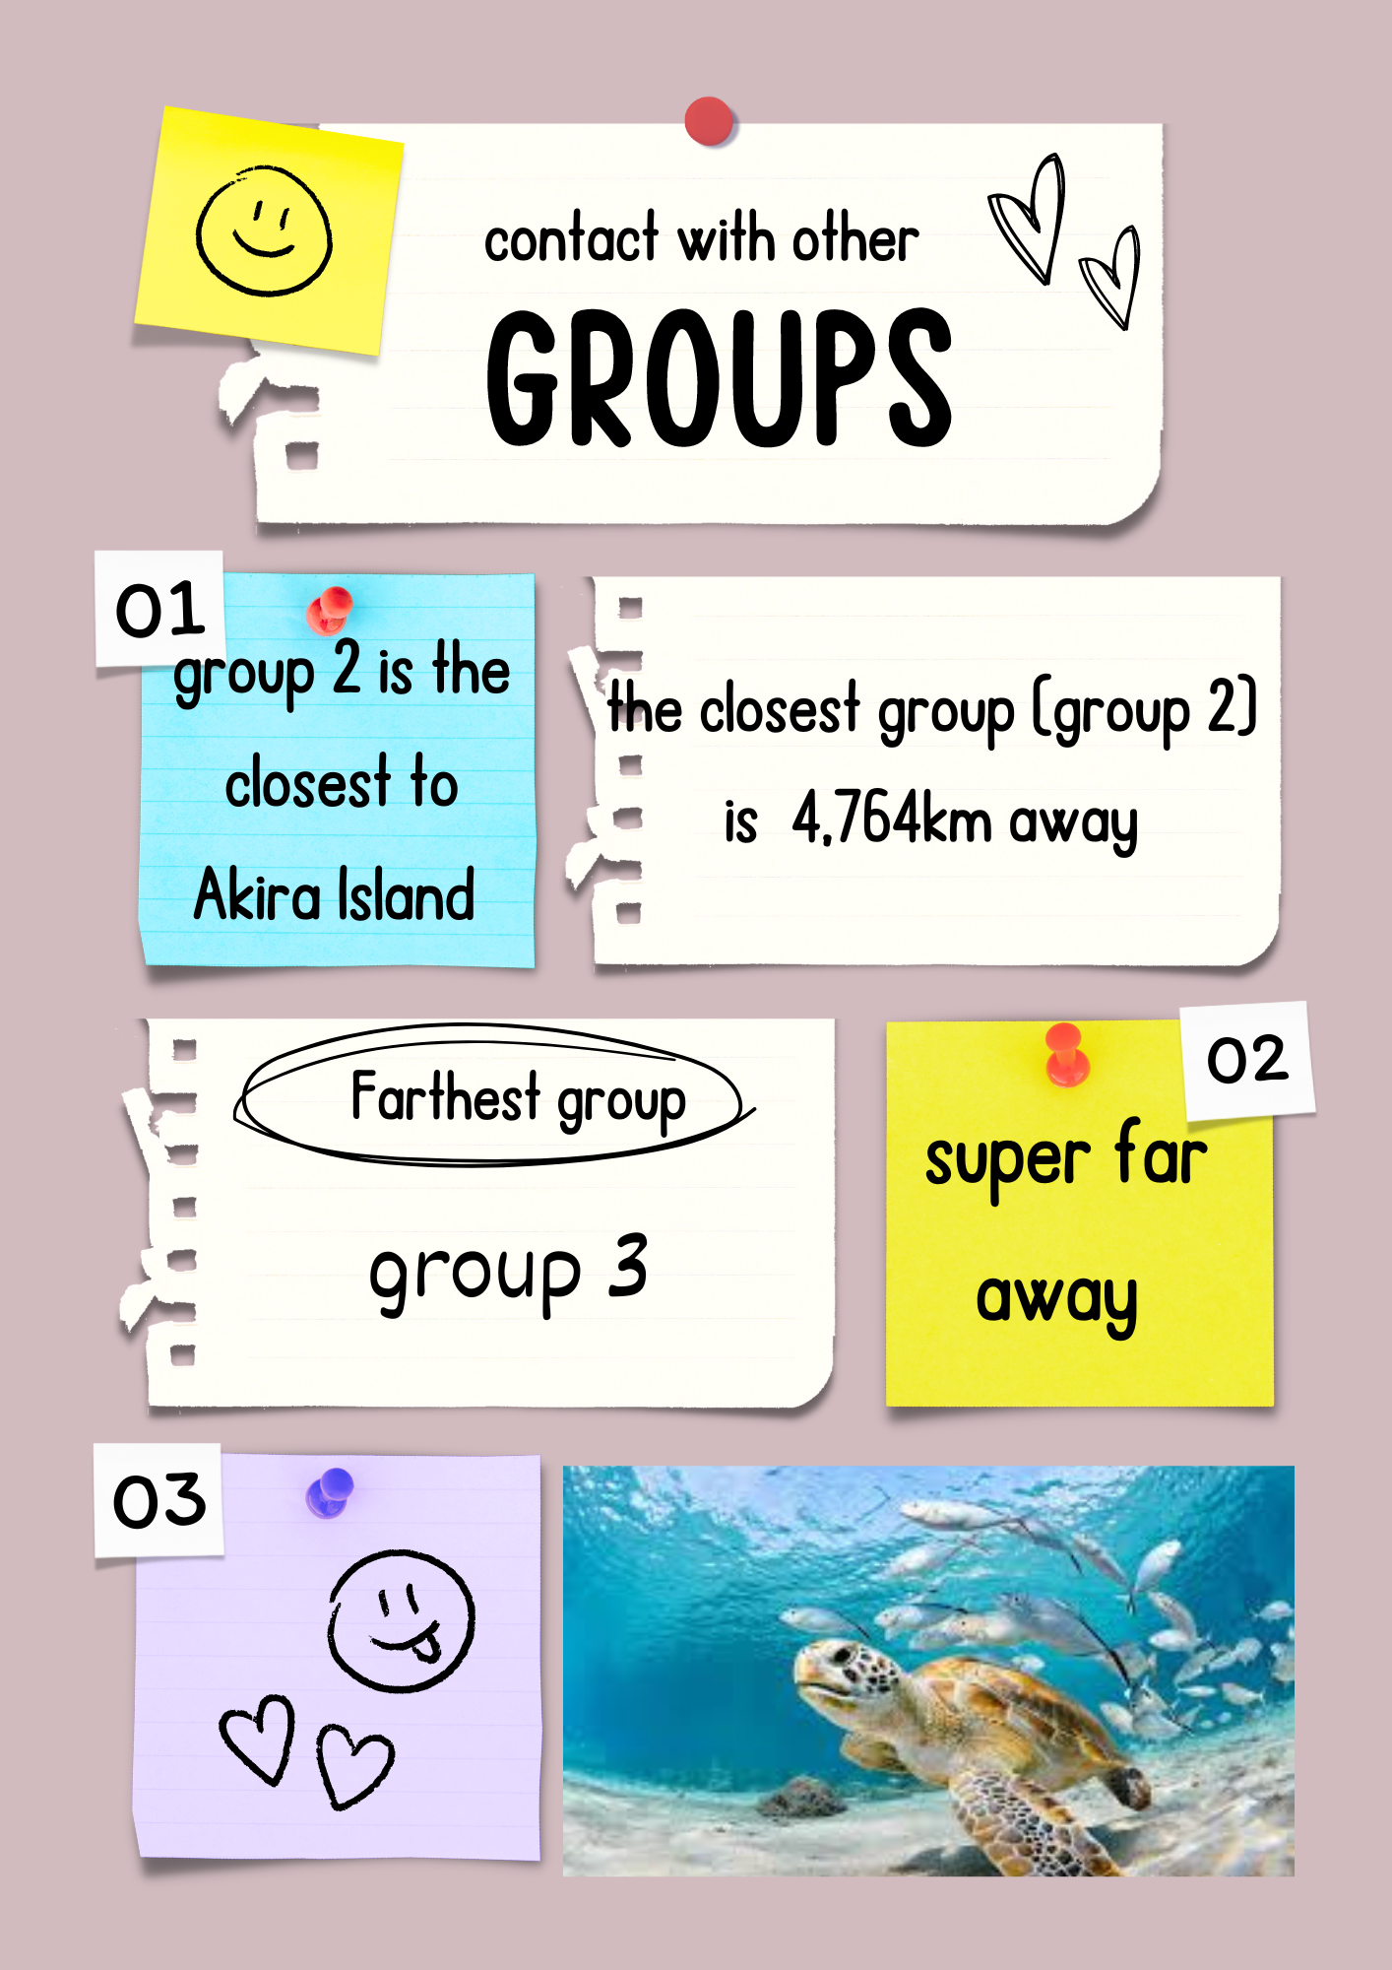
Akira island was formed from a underwater volcano and rose up to the surface creating the wonderful Akira island that we live on today.

Slide 8
THE END

